Slide 1


SNAKE GAME
BY
S T P HASMITHA
01

Slide 2

INTRODUCTION
The Enhanced Snake Game in Java is a modern, customizable take on the classic arcade game, designed to offer an engaging and visually appealing user experience.
Developed using Java Swing, it integrates interactive GUI elements, smooth animations, and advanced gameplay mechanics while maintaining the nostalgic charm of the original Snake game.
Unlike traditional snake games with a single gameplay style, this version allows players to personalize their gaming experience through an in-game settings menu, where they can choose the difficulty level, visual theme, and snake skin before starting. This ensures that both beginners and experienced players can enjoy the game at their own pace and preference.
The gameplay is enriched with dynamic obstacles, a coin reward system, and progressive level advancement. Each level not only increases the game speed but also adds more challenges, making the experience progressively harder and more exciting. Scoring is straightforward yet rewarding — apples increase both the snake’s length and the score, while coins serve as bonus rewards that appear randomly.
A persistent high score tracking system ensures competitive replayability, motivating players to beat their previous best.
The game also supports pause and restart functionalities, enabling players to manage their gameplay without restarting the program.
From a technical perspective, the project demonstrates the use of object-oriented design principles, efficient event handling, real-time rendering, randomization for item placement, and file handling for data storage.
These features make it not just a fun game but also a robust programming project showcasing advanced Java concepts.
02

Slide 3
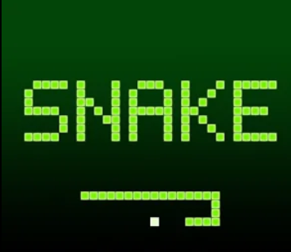
OBJECTIVES
The primary objective of the Enhanced Snake Game project is to design a fun, challenging, and visually appealing game that demonstrates advanced Java programming concepts.
Goals:
Reimagine the classic Snake game with modern enhancements.
Offer customization options (difficulty, themes, snake skins) to suit player preferences.
Implement progressive gameplay with speed increases, level-ups, and new obstacles.
Add a coin reward system to boost engagement.
Provide smooth animations and responsive controls.
Enable persistent high score tracking for competitive replayability.
Demonstrate Java Swing, file I/O, and OOP concepts effectively.
03

Slide 4
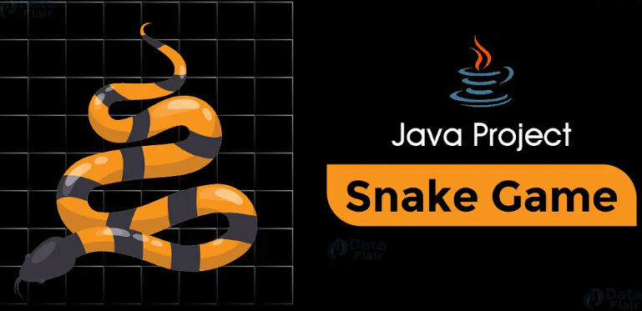
KEY FEATURES
Multiple Difficulty Levels – Easy, Medium, Hard, each with different snake speeds and challenges.
Theme Customization – Classic, Dark, Neon, Light modes for varied visual experiences.
Snake Skin Options – Green, Cyan, Magenta, Rainbow for personalization.
Bonus Coin System – Randomly appearing coins for extra points.
Dynamic Obstacles – Increasing in number and position randomness as levels progress.
Level Progression – Levels up every 5 apples eaten, with speed and challenge scaling.
Pause & Resume Gameplay – Players can pause mid-game and resume without losing progress.
Restart Option – Quick restart after Game Over without relaunching the program.
Persistent High Score Tracking – Saved locally using file handling for competitive replay.
04

Slide 5
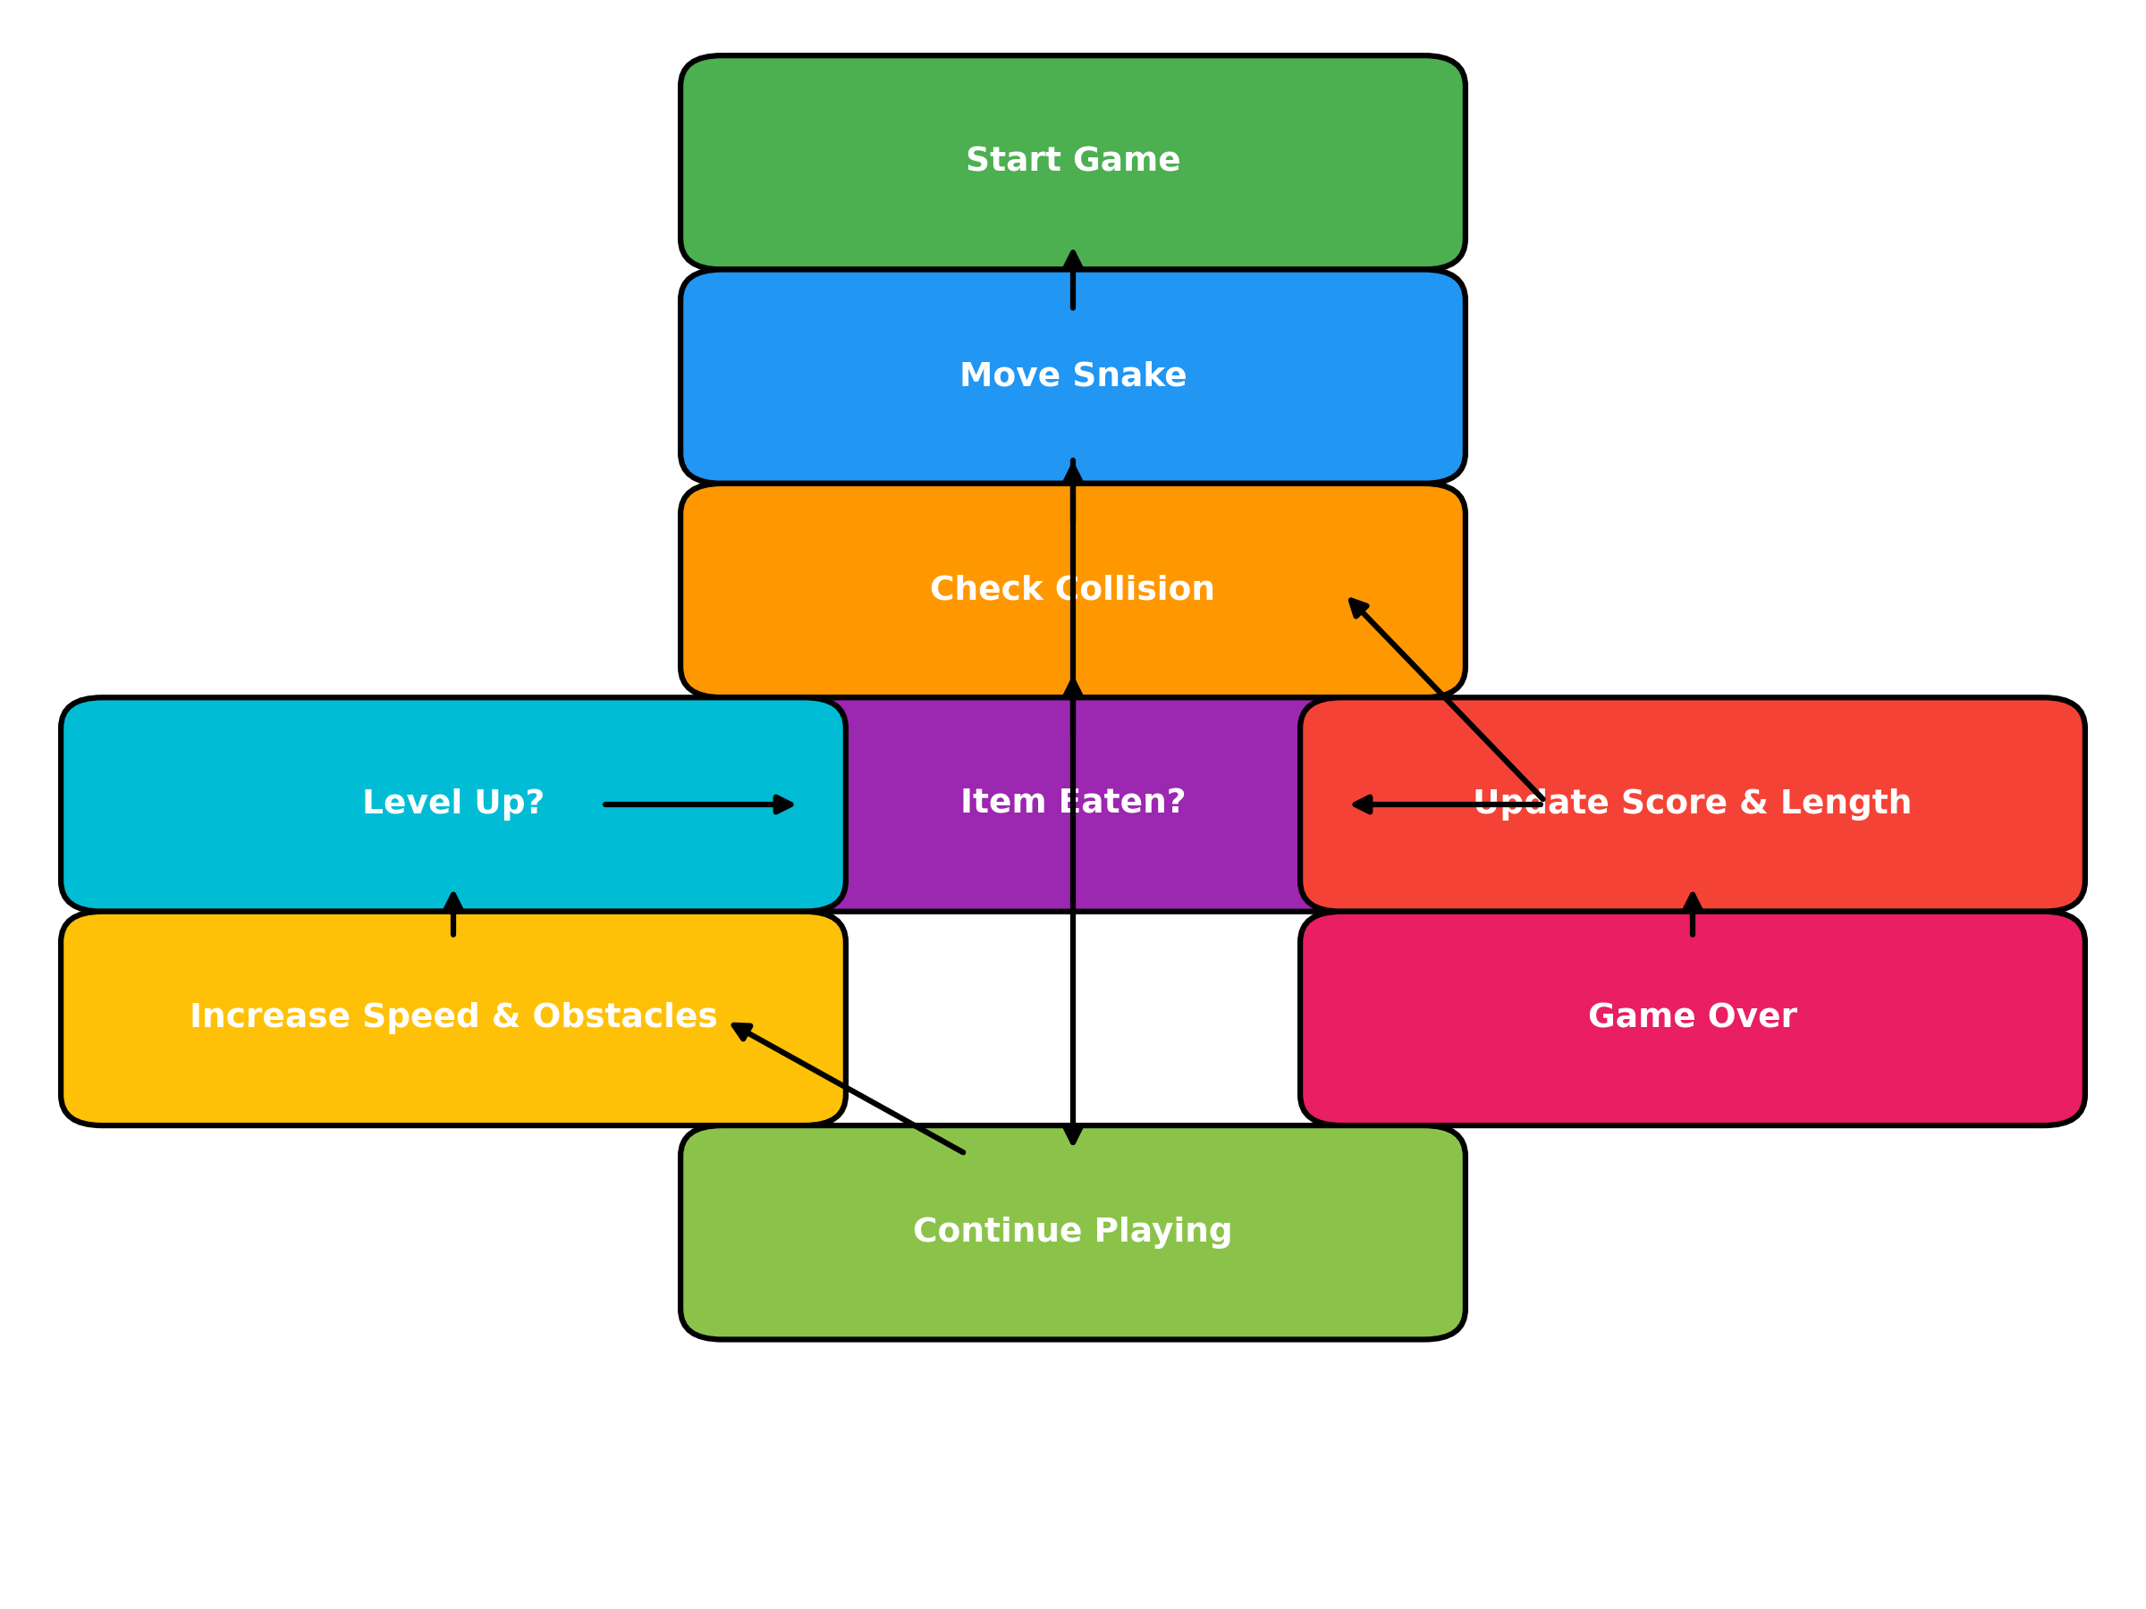
GAME MECHANICS
05

Slide 6

TECHNICAL IMPLEMENTATION
Programming Language: Java
GUI Framework: Swing
Main Classes:
SnakeGame – Game frame and initialization.
GameSettings – Difficulty, theme, and skin selection menu.
SnakePanel – Core gameplay logic, rendering, collision handling.
Core Concepts Used:
Event Handling & Keyboard Controls
Timer for real-time movement
Randomization for item placement
File I/O for high score persistence
Object-Oriented Programming principles
07

Slide 7


CHALLENGES
Collision Detection Accuracy – Ensuring the game correctly identifies wall, self, and obstacle collisions.
Random Item Placement – Preventing apples and coins from spawning on the snake’s body or obstacles.
Speed Management – Balancing gameplay so it’s challenging without being frustrating.
File Handling – Safely storing and updating the high score in highscore.txt.
Smooth Controls – Avoiding sudden reversal bugs that cause instant Game Over.
06

Slide 8
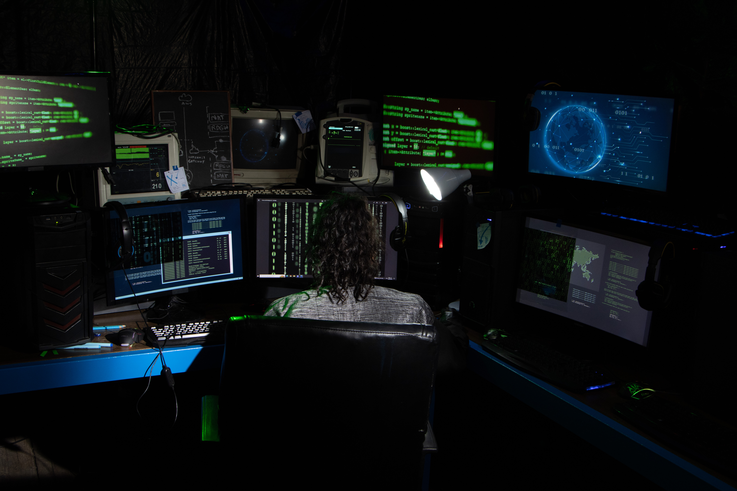
FUTURE ENHANCEMENTS
Multiplayer Mode – Two-player snake battles on the same board.
Power-Ups – Items that slow down the game, make the snake pass through walls, or double points.
Customizable Skins – Change snake and background themes.
Online Leaderboard – Compete with friends globally.
Mobile Touch Support – Swipe gestures for movement.
Save/Resume Feature – Pick up the game later from where you left off.
08

Slide 9
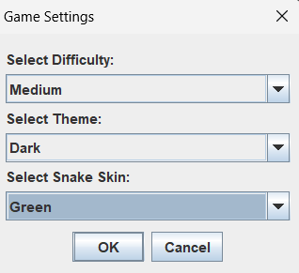
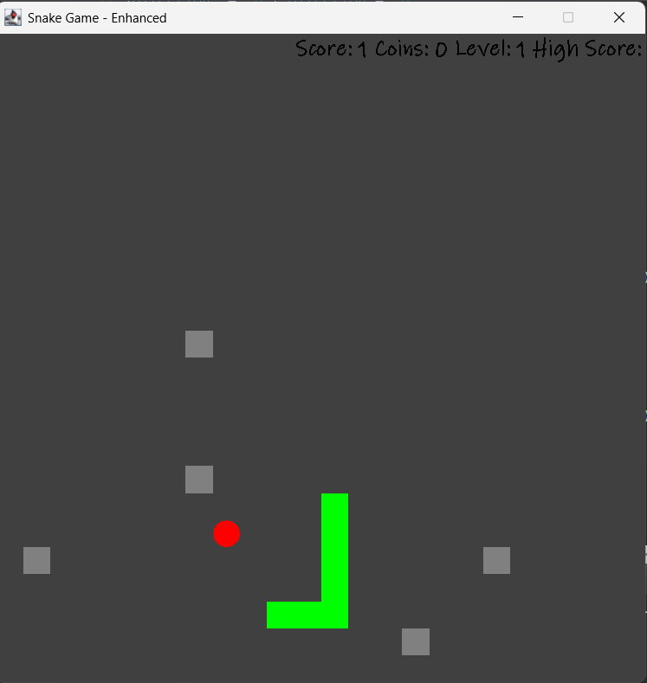
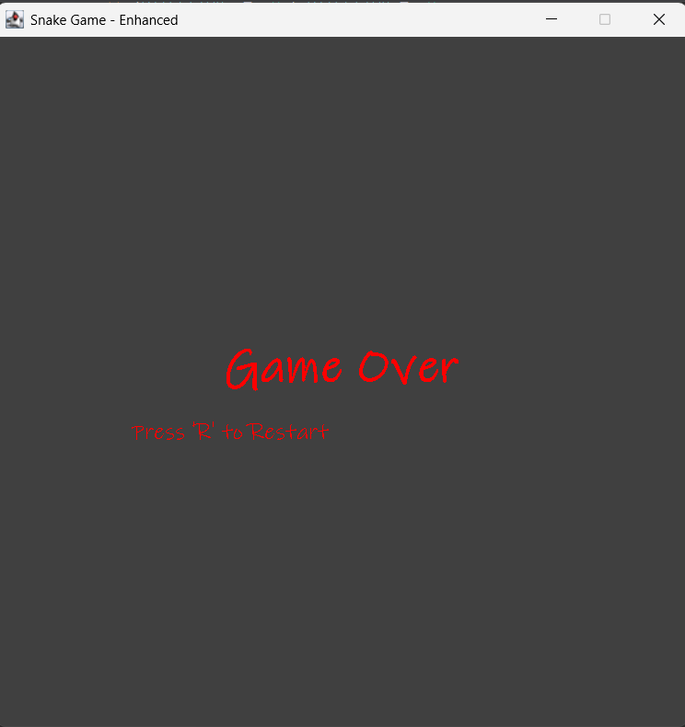
IN-GAME HIGHLIGHTS
09

Slide 10


THANK YOU
10

